Slide 1







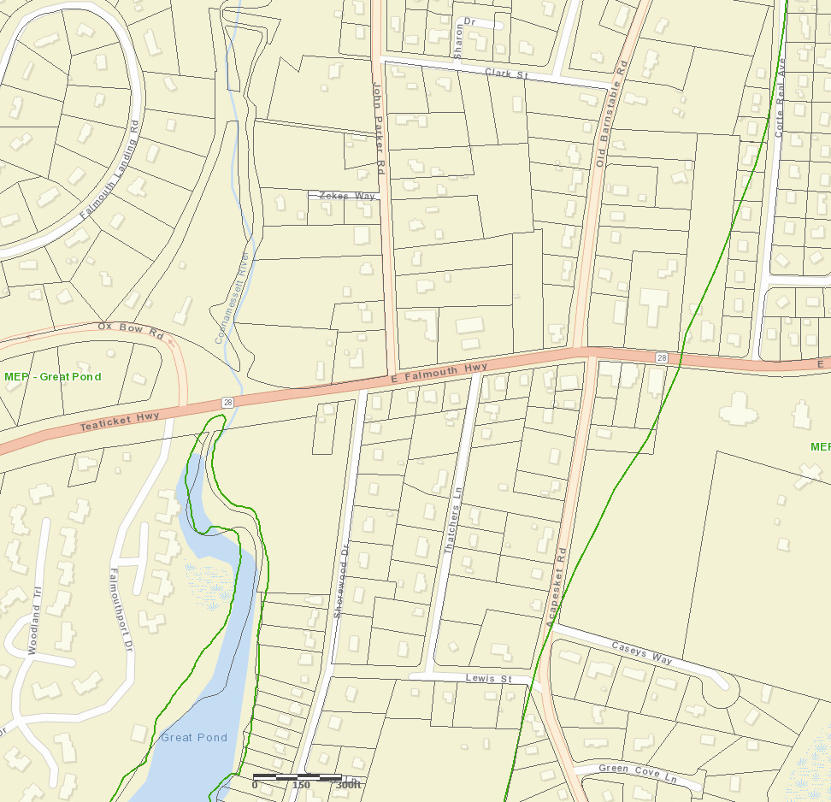
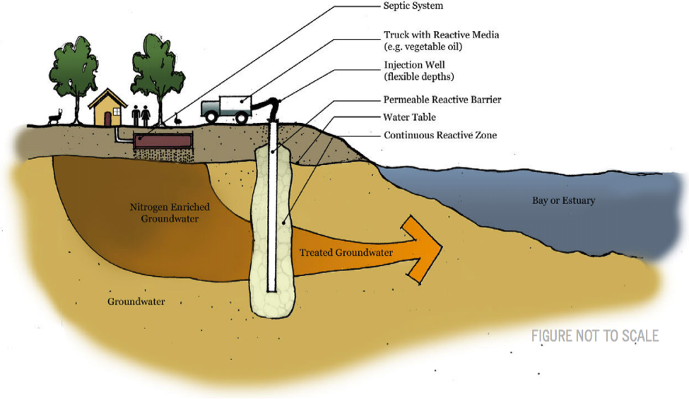
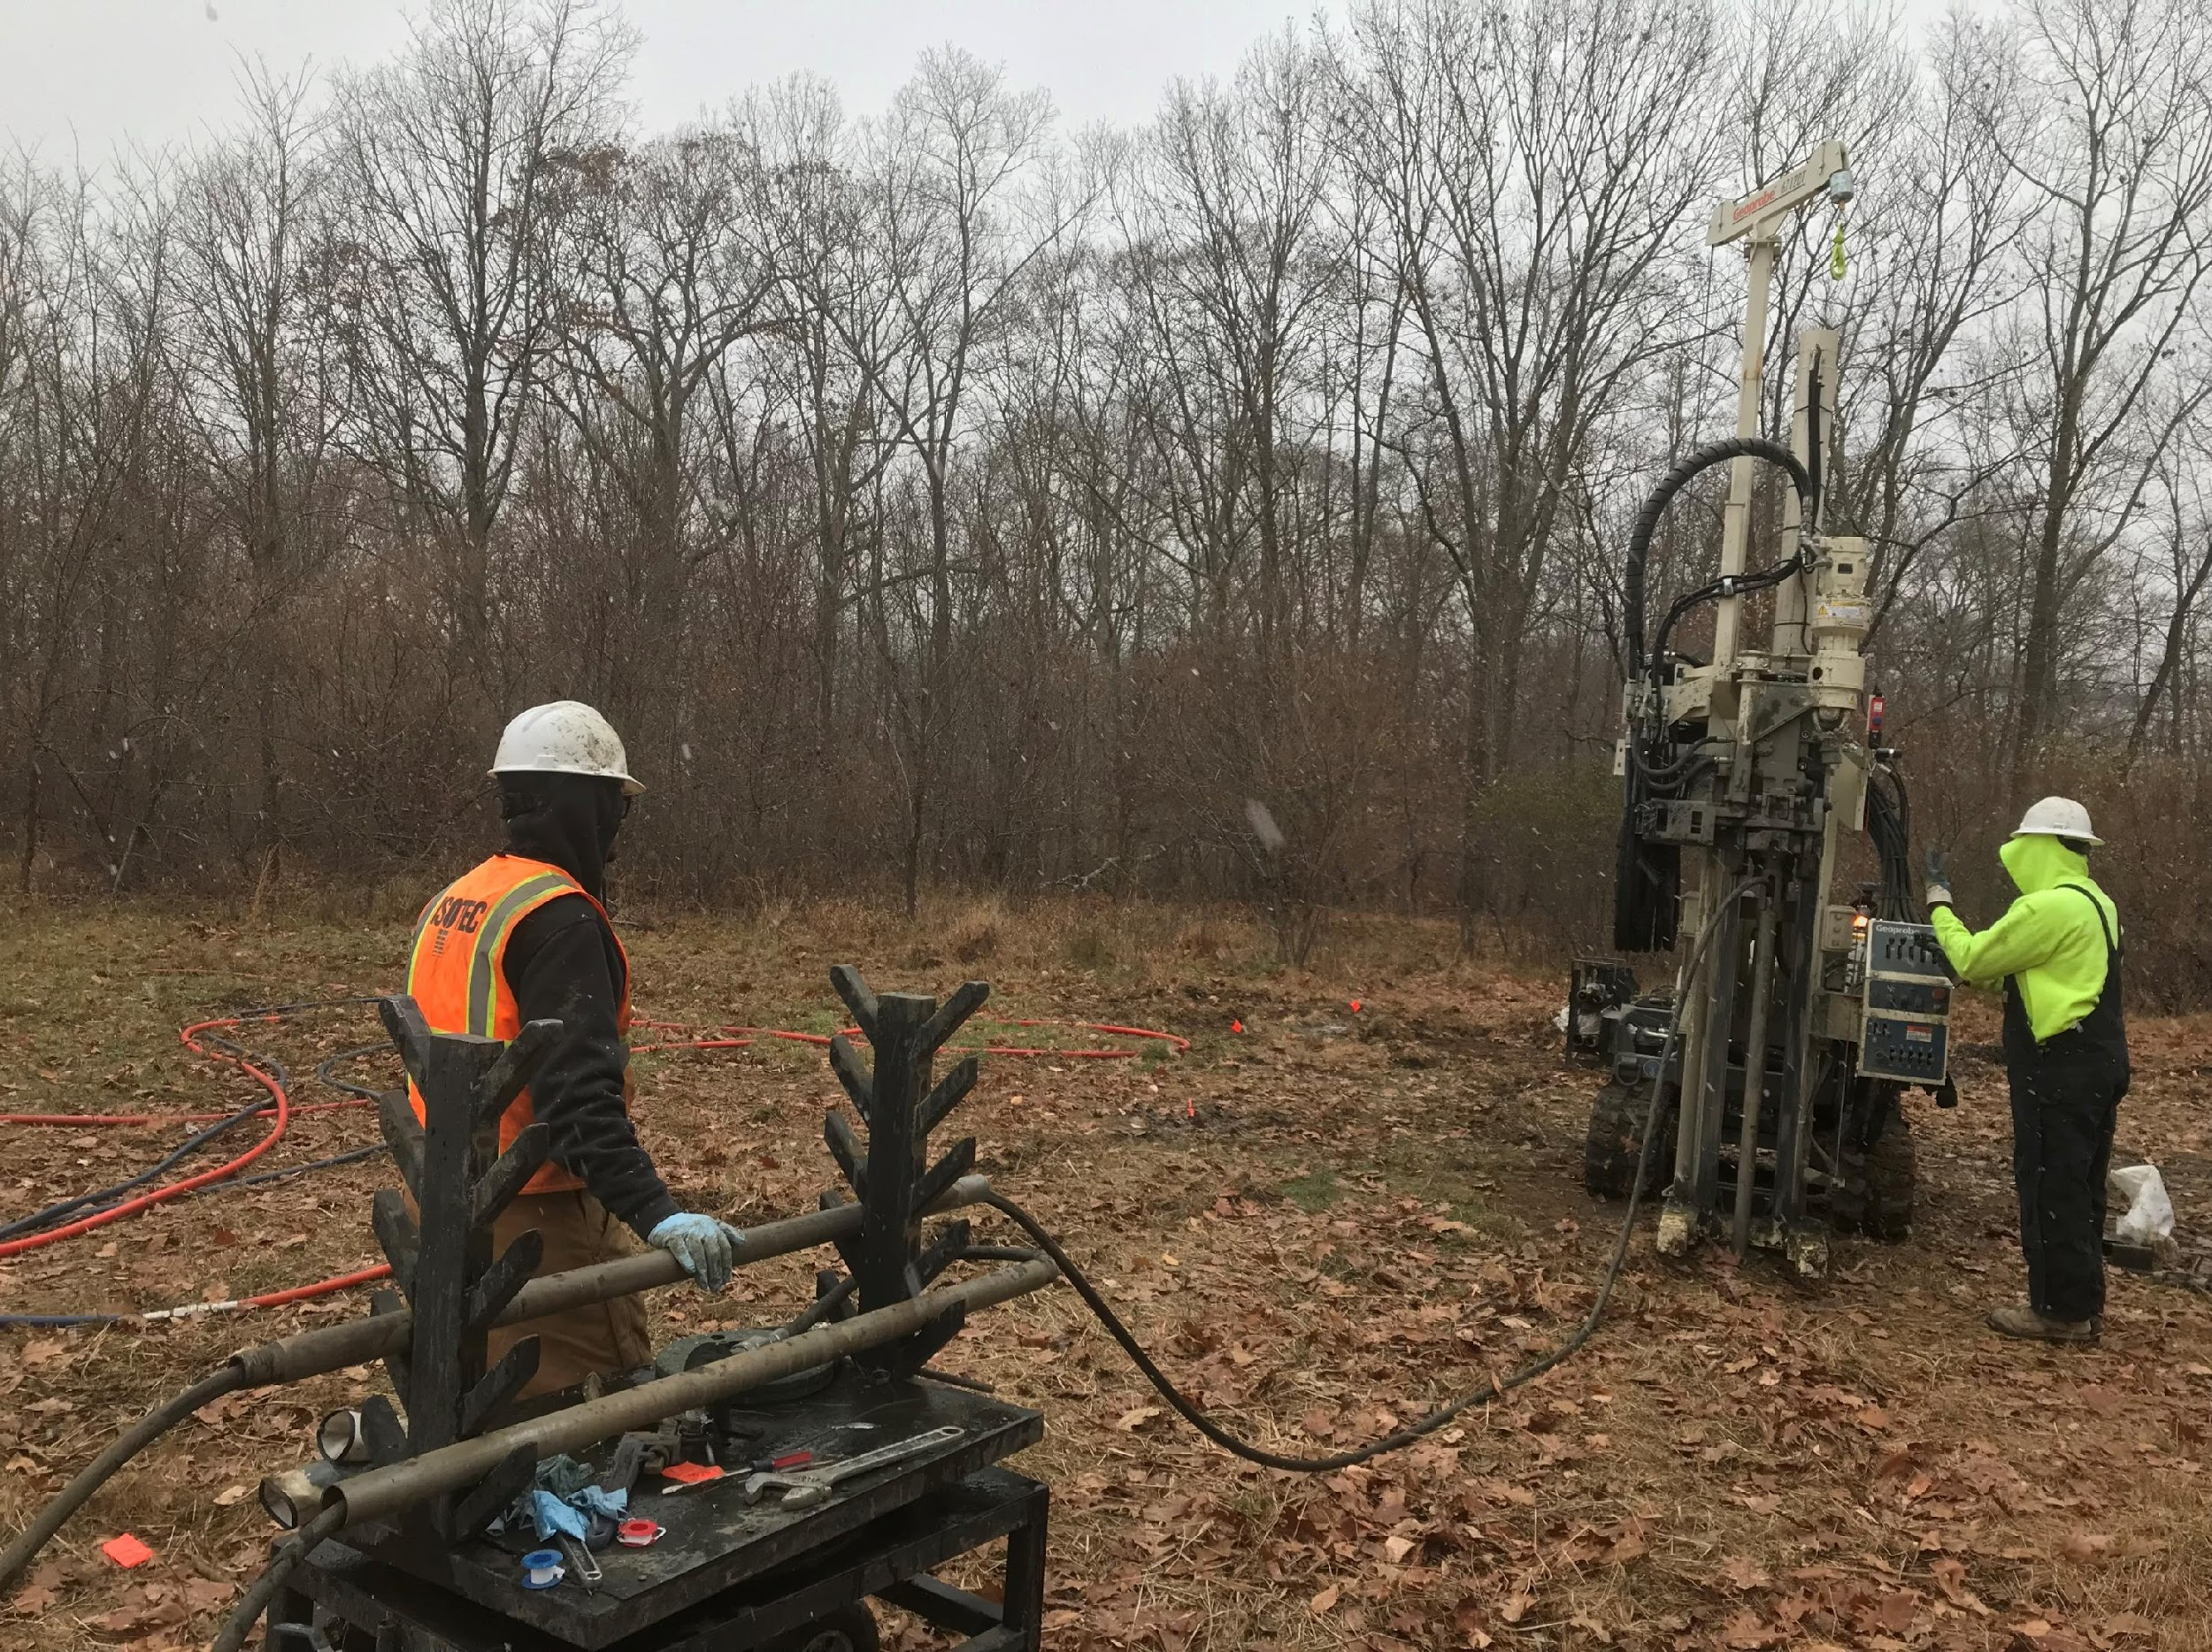
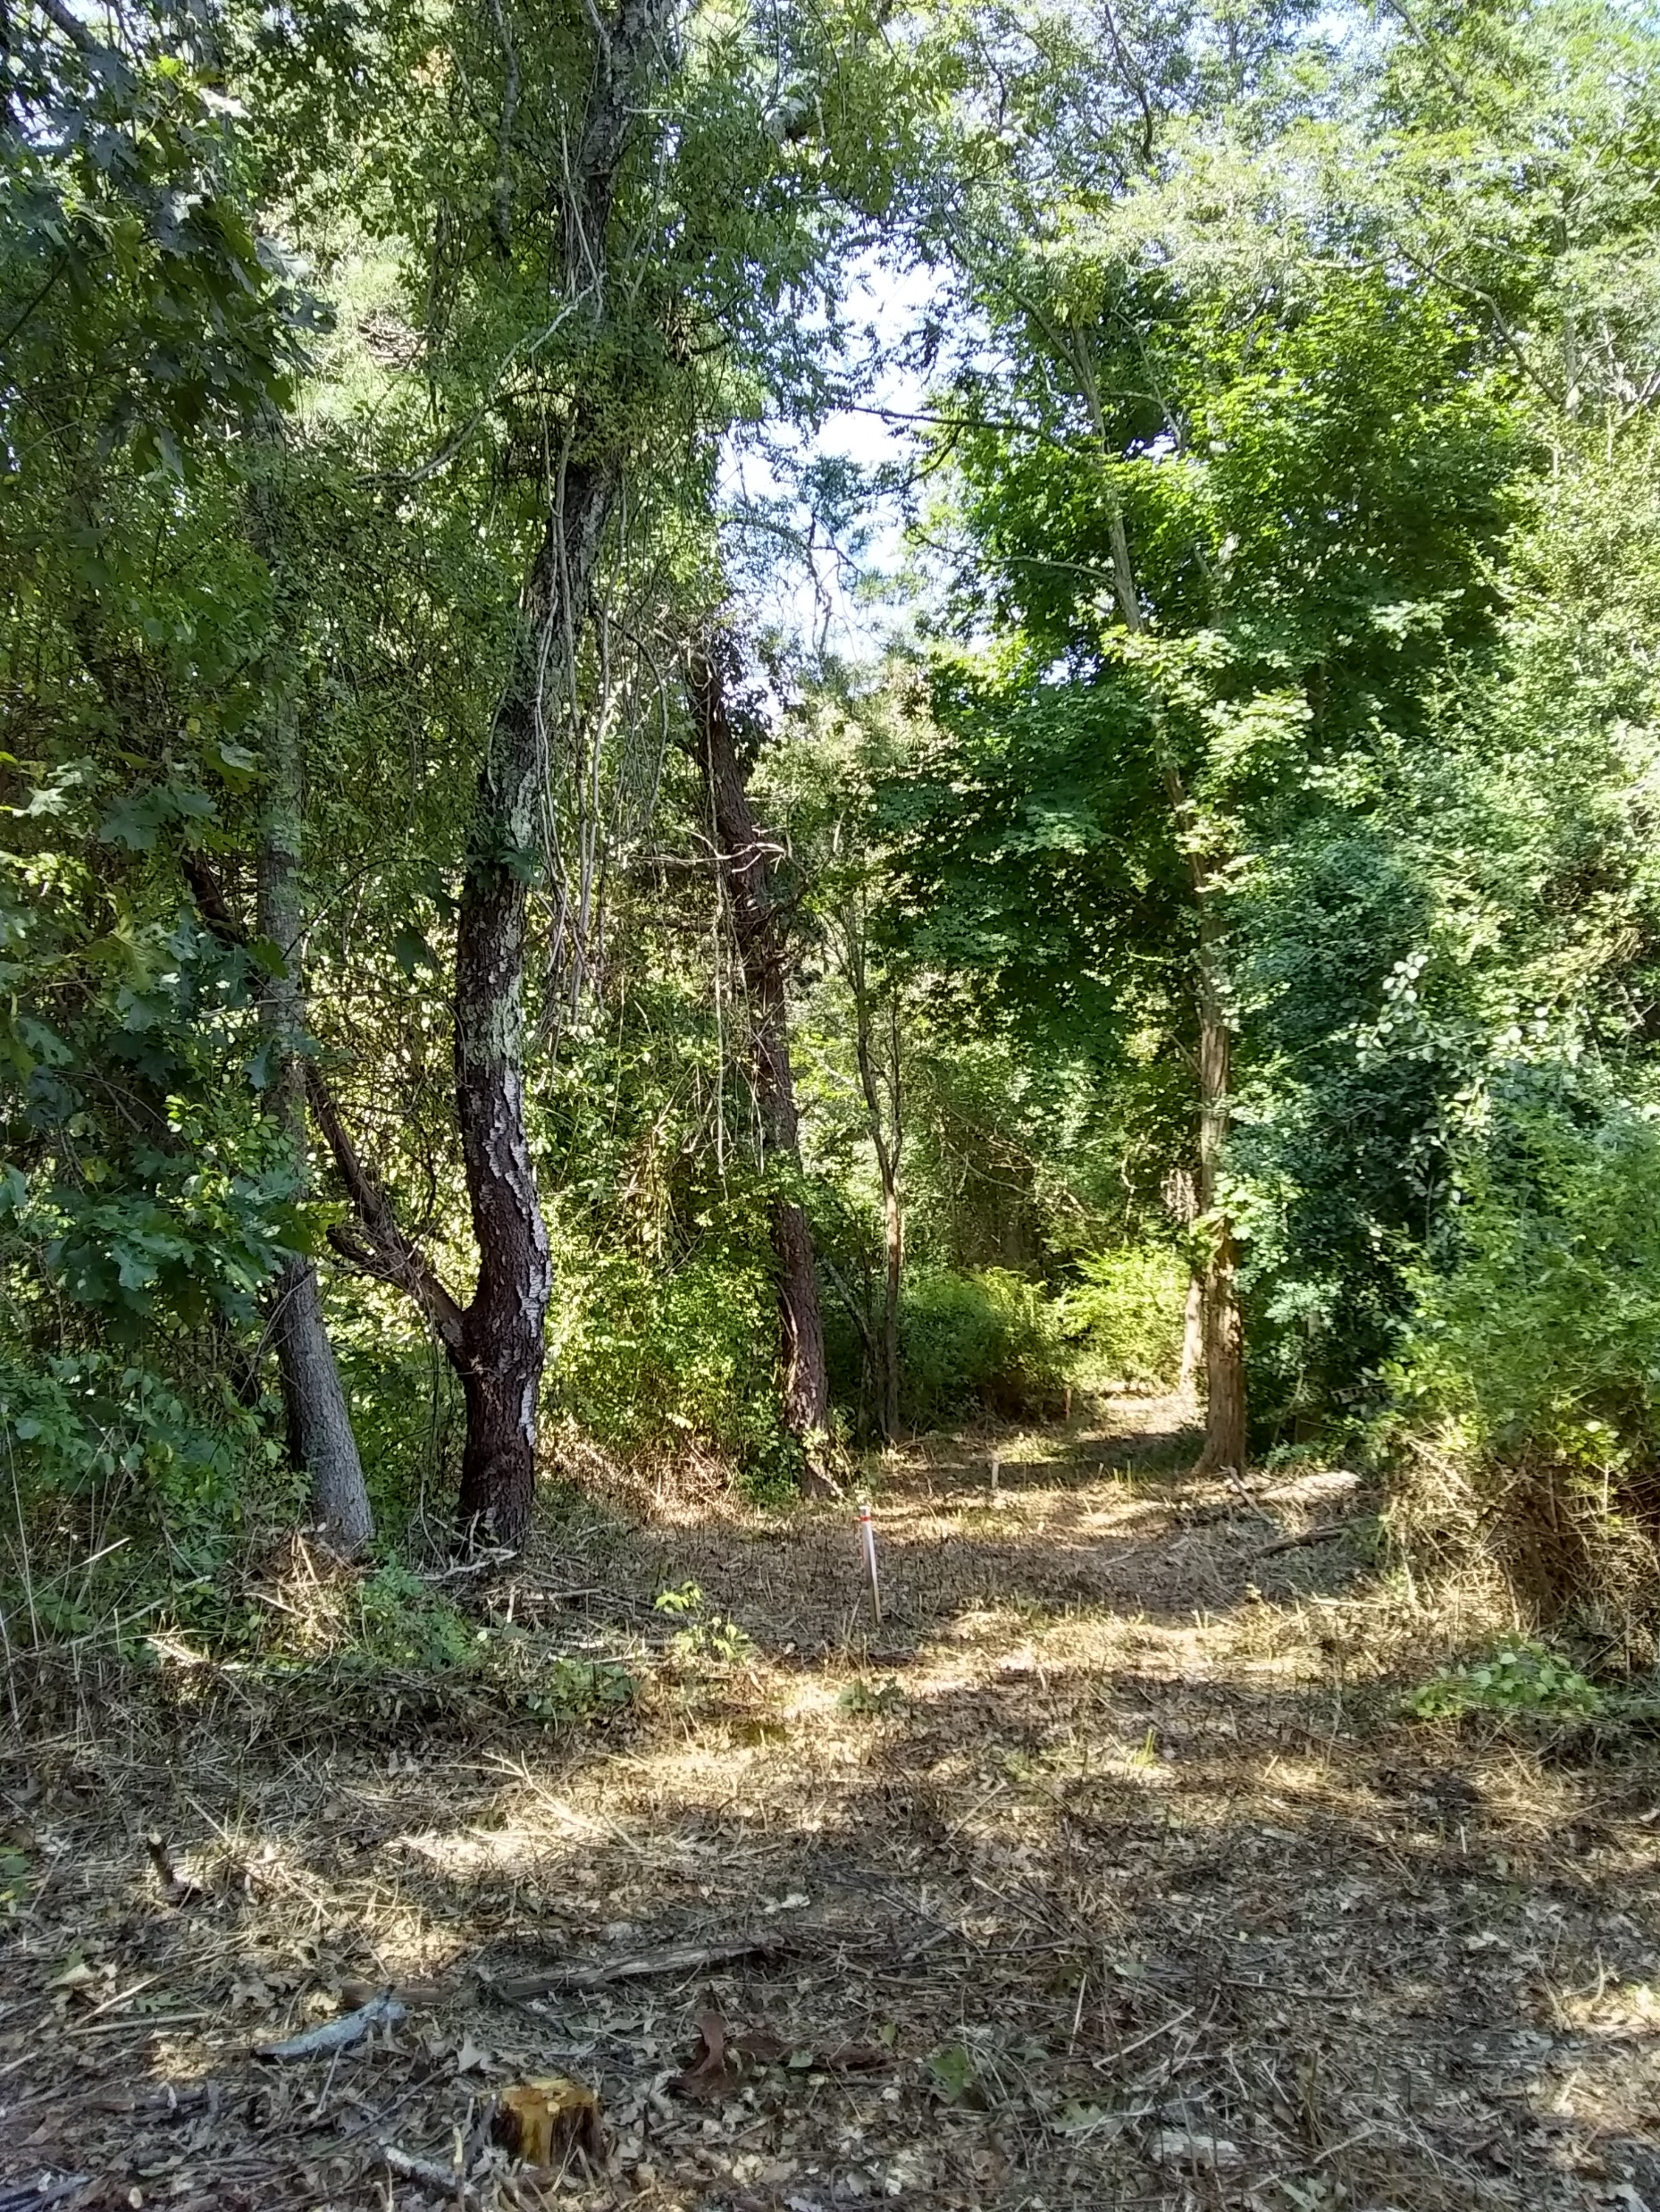
Implementing a Pilot-Scale Permeable Reactive Barrier For Groundwater Nitrogen Remediation in Great Pond
What is a Permeable
Reactive Barrier?
What about
environmental impacts?
How much nitrogen
will it remove?
A PRB is a means to intercept nutrient enriched groundwater using a carbon source such as Vegetable Oil. Carbon stimulates bacterial conversion of nitrate in the groundwater to nitrogen gas thus reducing the nutrient concentration before it enters the estuary.
Emulsified vegetable oil (EVO) is a soybean-based, food grade substrate. Brush clearing is required for the well installations and injections. Overall, minimal impact is expected on the ecological landscape.
Performance and residual impacts of EVO on the groundwater will be regularly monitored through a network of subsurface monitoring wells.
This project will consist of a 120’ PRB. A PRB of this length is expected to remove upwards of 530 kg N/yr. This is equal to the nitrogen from 130 houses in the upper region of the estuary. There is potential for future extension of the PRB to 300’.
Groundwater Flow
PRB Location
Expected location of the PRB at
0 Shorewood Drive.
Credit: Cape Cod Commission
Direct push drill rig installing temporary injection point
Why is the Shorewood Drive location ideal?
How long will it last?
Shallow depth to the groundwater
High nitrate concentration
Moderate groundwater velocity
Near the head of the estuary where flushing is limited
Installing a PRB is a more cost-effective approach to nitrogen remediation in the upper watershed than sewering.
Determining the longevity of the EVO in the field is a major goal of this project. This location is a pilot scale project and has been designed to last 2 years initially. A full-scale system is expected to last between 5 and 10 years.
Questions?
Clearing at Shorewood Drive for the PRB mapping. Clearing will not remove any mature trees, only underbrush and small saplings. Pictured represents the anticipated amount of clearing required for the PRB installation.
For more information contact:
The Falmouth Water Quality
Management Committee
wqmc@falmouthmass.us

